Slide 1

Design and Control of Photonic Neural Networks Applied to High Bandwidth Classification
Ethan Gordon ‘17
May 9, 2017
<number>

Slide 2
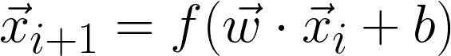
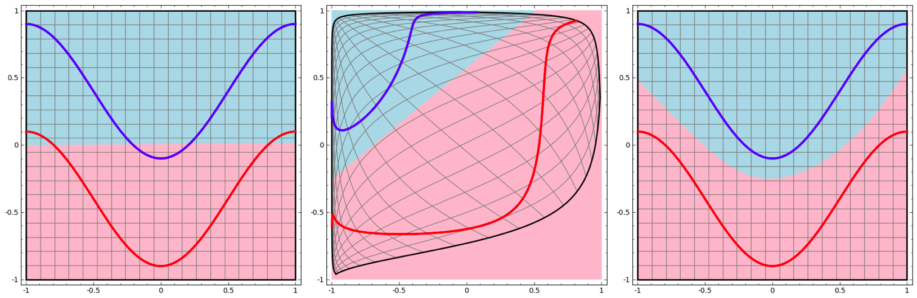
Neural Networks, Briefly
Nonlinearity and Weighted Addition:
<number>
Notes:
Because everybody and their car lab project is using neural networks this year.
Nonlinearity

Slide 3
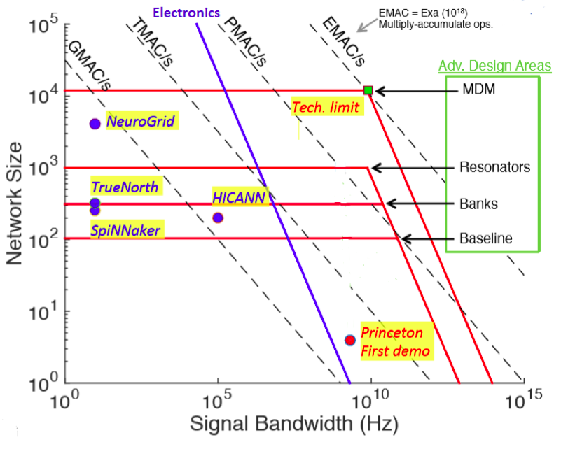
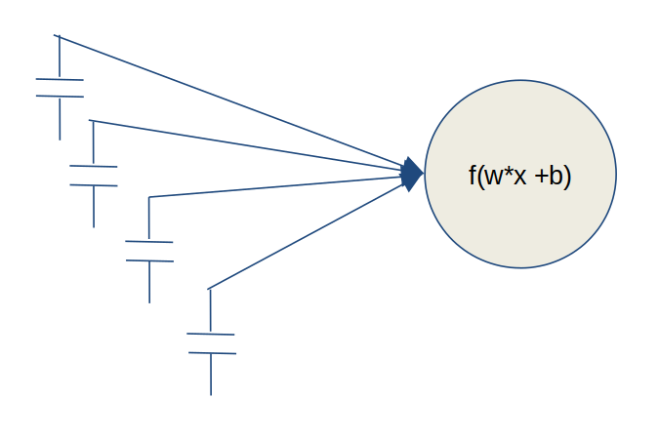
A Case for Photonics
Throughput = Bandwidth * Layer Size
<number>
Notes:
Fan-in.
TrueNorth: 1kHz time step (limit to bandwidth per neuron), 256x256 layer size

Slide 4
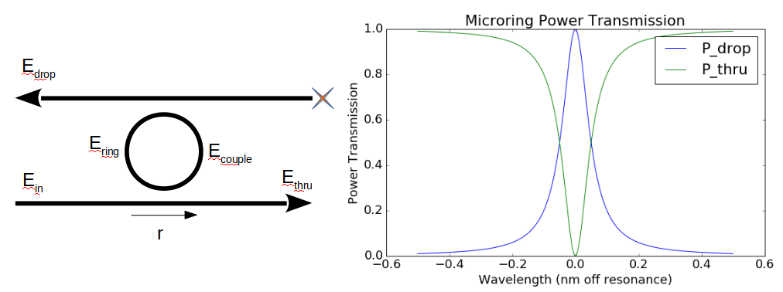
Microring Resonators: Operating Principle
Resonant Frequency is Temperature-Dependent
<number>
Notes:
Lorentzian Function

Slide 5
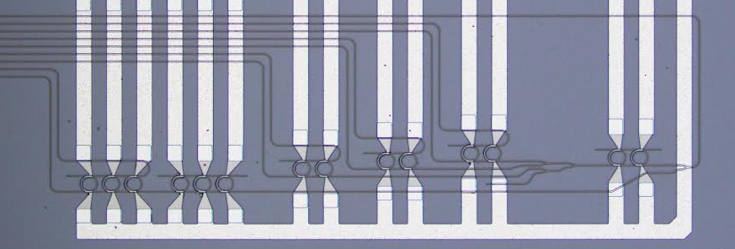
Putting it Together: A 2-3-1 Feed-Forward Network
3x2 Weight Bank
2-Axon
1x3 Weight Bank
3-Axon
<number>
Notes:
Star Network

Slide 6
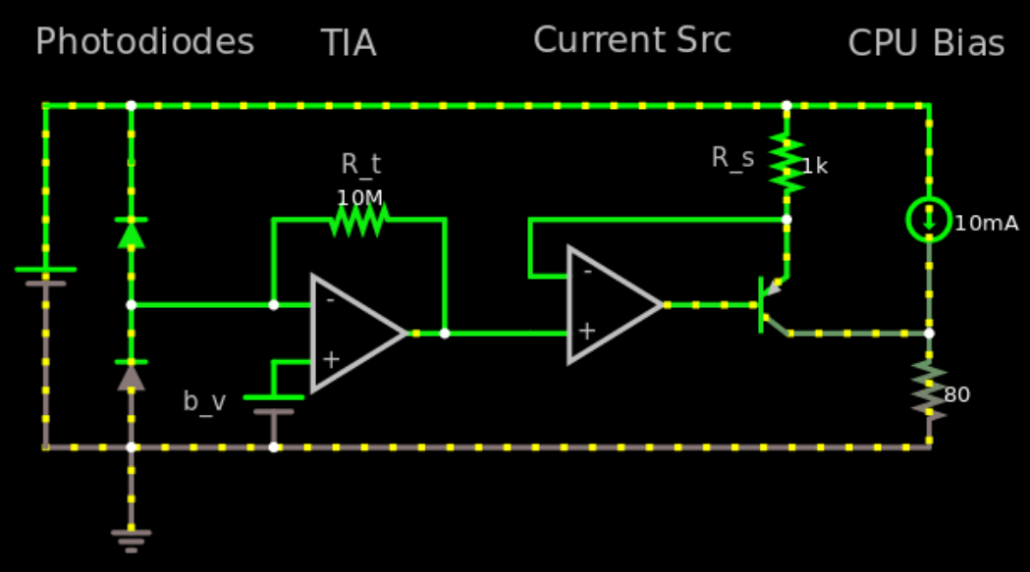
Putting it Together: A 2-3-1 Feed-Forward Network
<number>

Slide 7
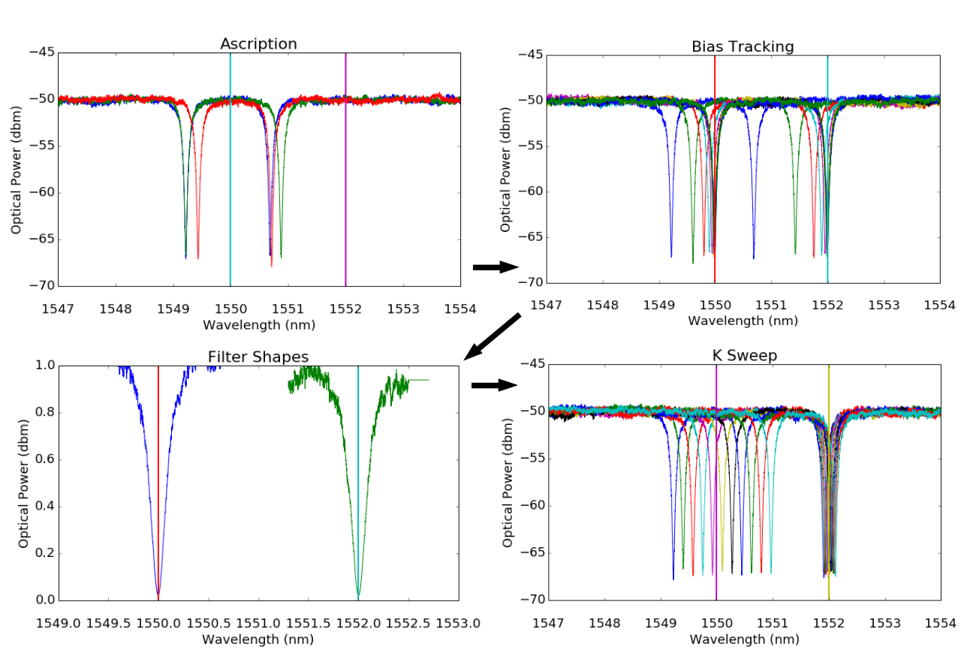
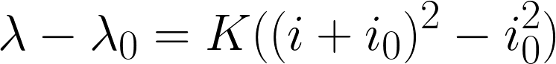
Thermal Calibration: Basic Procedure
Goal: Map electrical state and optical weights and biases.
Ascription
Background Removal
Track to Bias
Pull Filter Shapes
Determine K Matrix
<number>

Slide 8
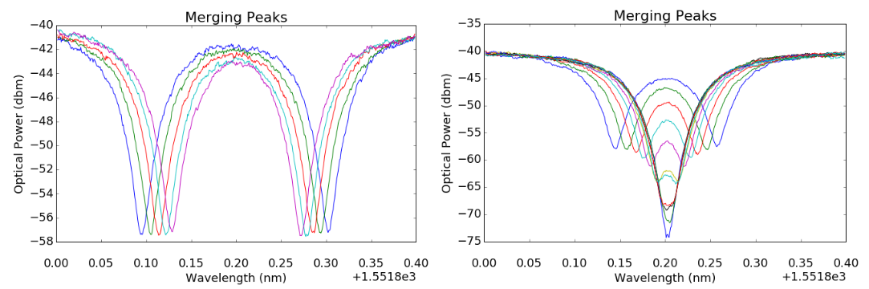
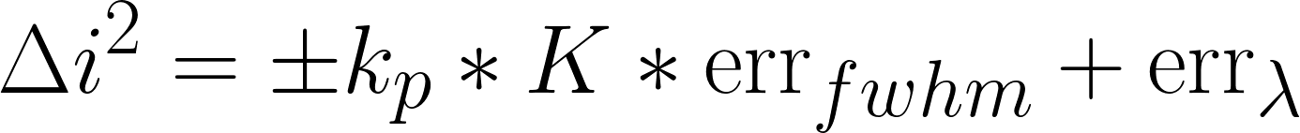
Thermal Calibration: Cascaded Calibration
Goal: Map electrical state and optical weights and biases.
(
)
<number>
Notes:
Because everybody and their car lab project is using neural networks this year.

Slide 9
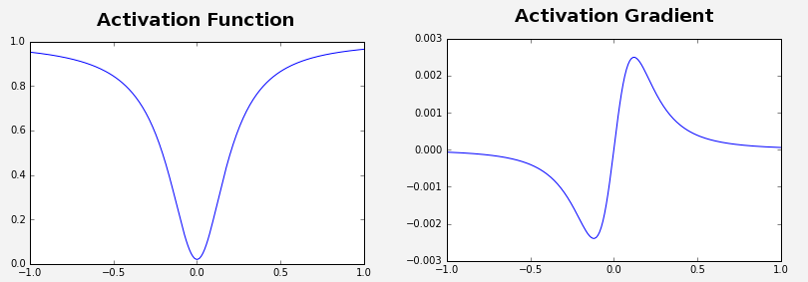
Network Training: Model
Activation Function: Current -> Power -> Wavelength Shift
<number>
Notes:
Because everybody and their car lab project is using neural networks this year.

Slide 10
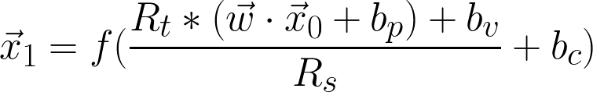
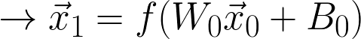
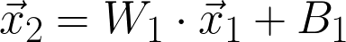
Network Training: Model
<number>
Notes:
Because everybody and their car lab project is using neural networks this year.

Slide 11
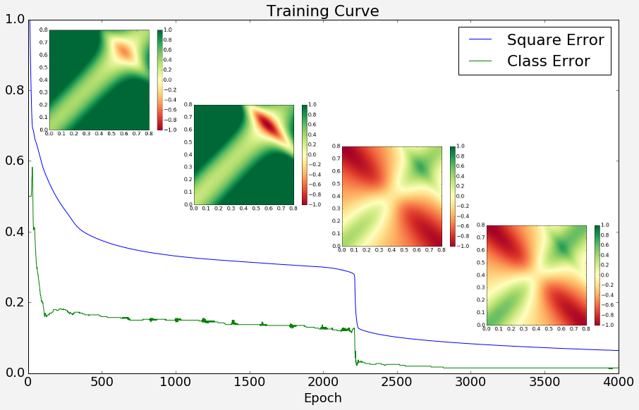
Network Training: Backpropagation
<number>
Notes:
Because everybody and their car lab project is using neural networks this year.

Slide 12
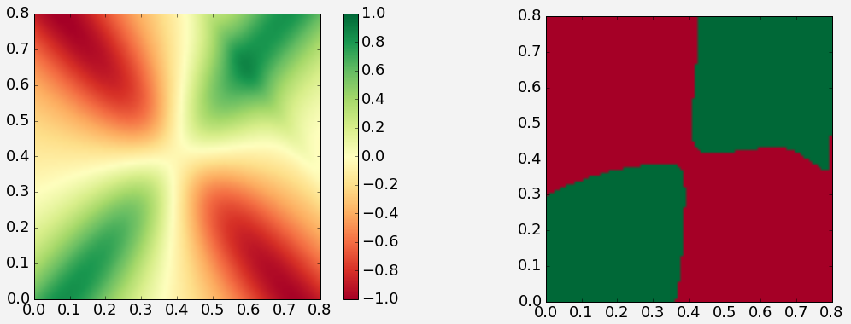
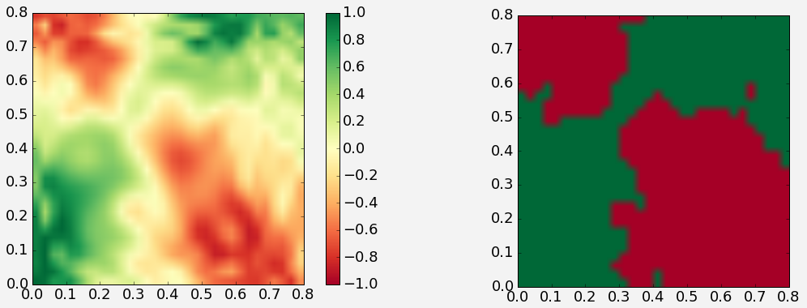
Network Training: Simulation
Backprop Output:
Network Simulation:
<number>
Notes:
Because everybody and their car lab project is using neural networks this year.

Slide 13
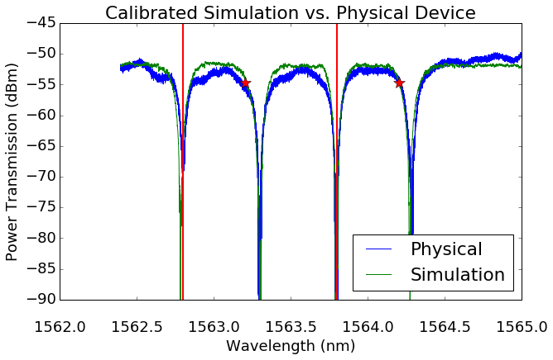
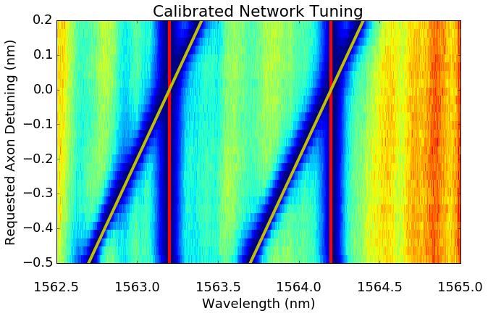
Experimental Validation: Calibration
<number>
Notes:
Because everybody and their car lab project is using neural networks this year.

Slide 14
Questions?
<number>
Notes:
Because everybody and their car lab project is using neural networks this year.

Slide 15
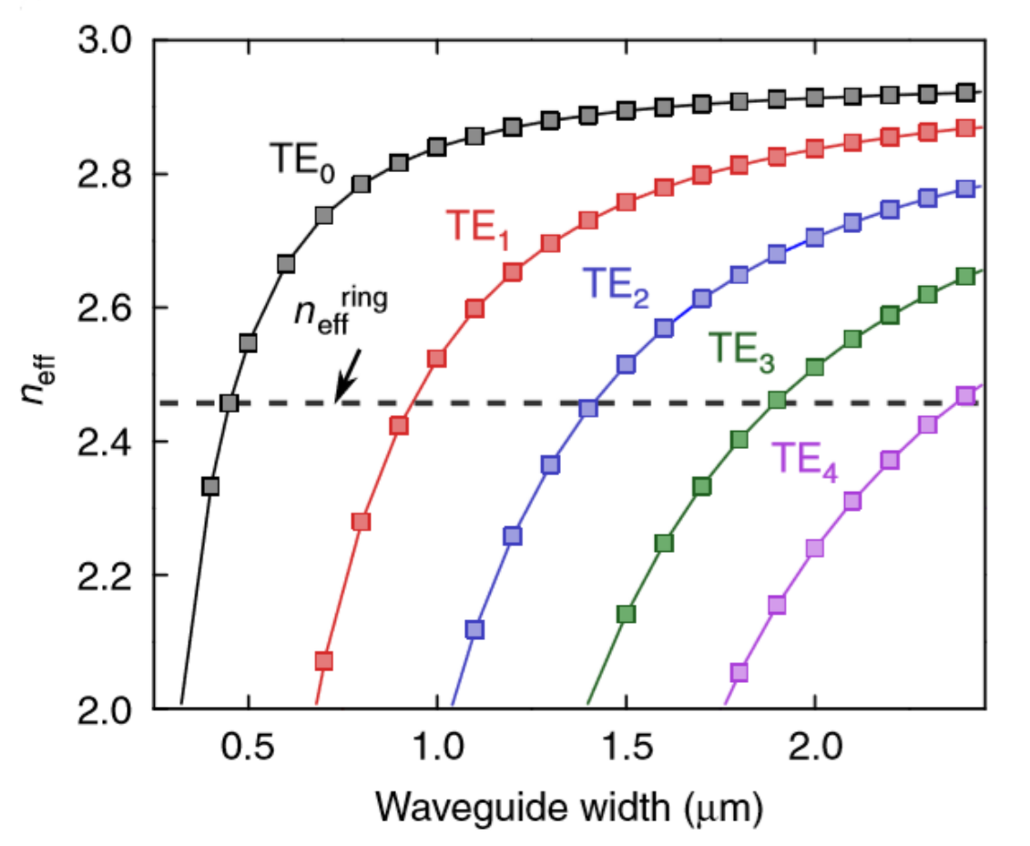
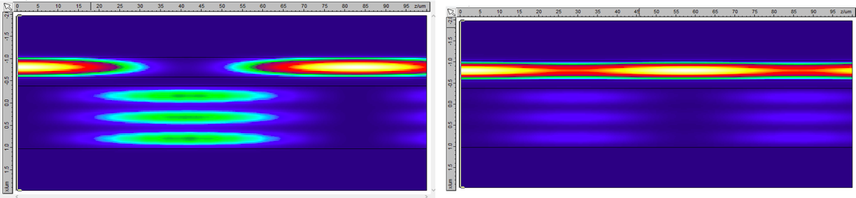
Future Work: Multi-Mode Waveguides
<number>

Slide 16
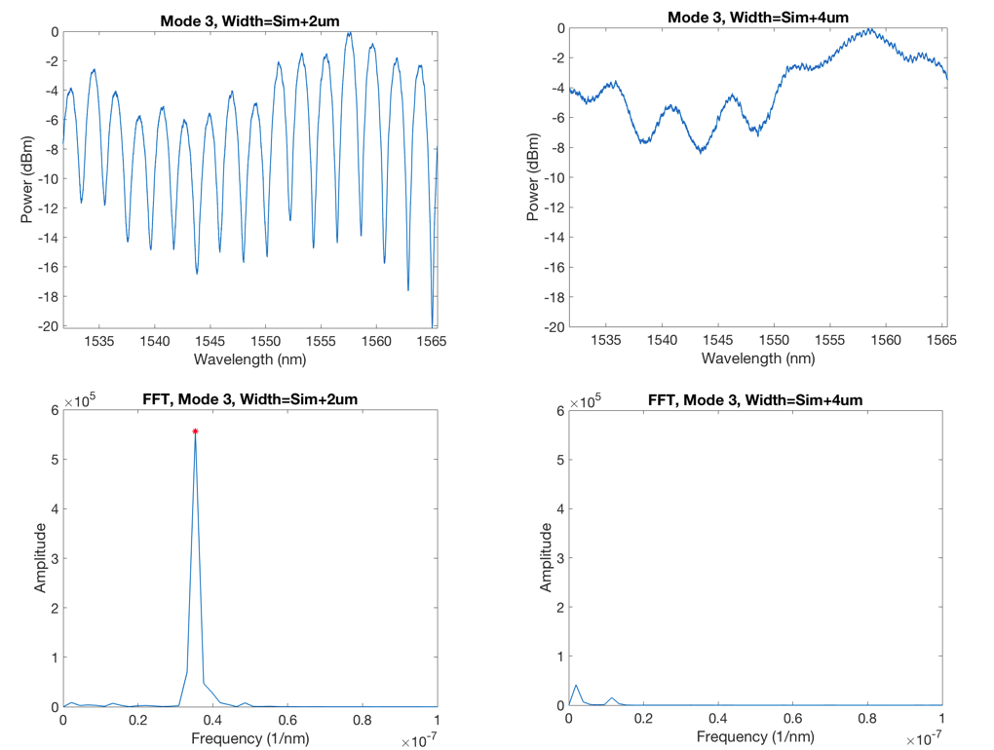
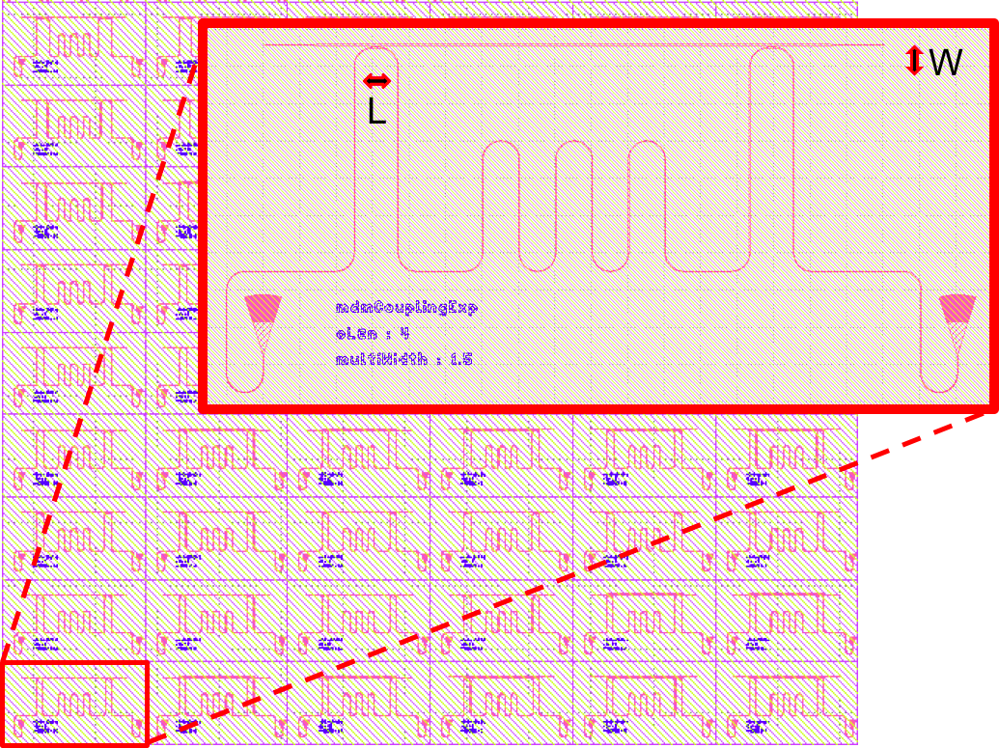
Future Work: Multi-Mode Waveguides
<number>

Slide 17
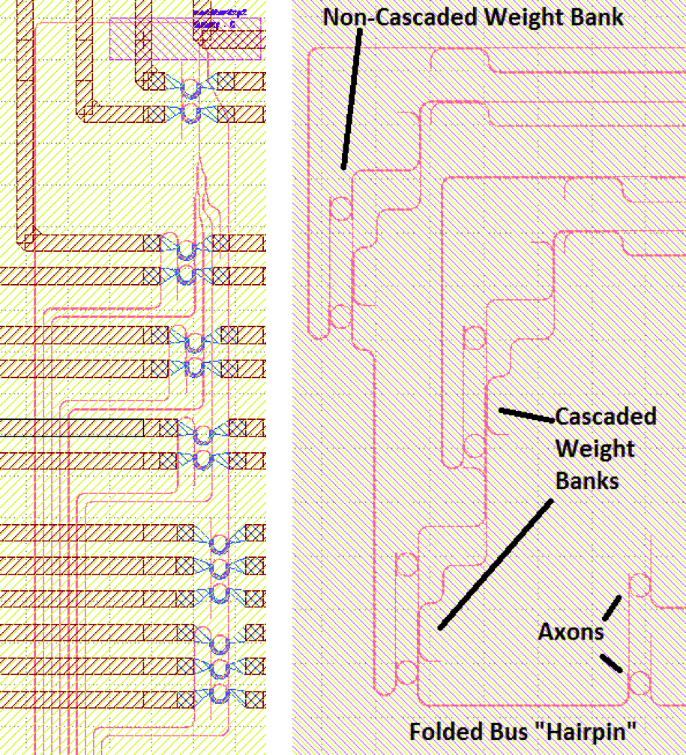
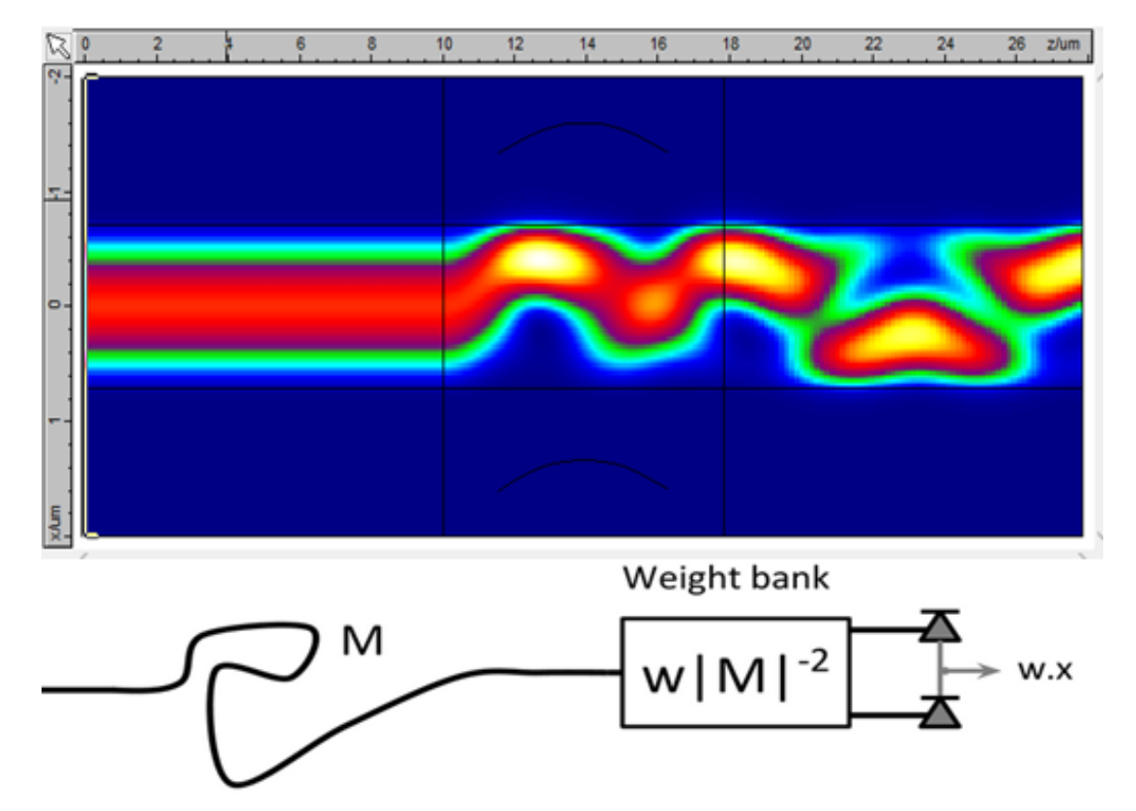
Future Work: Multi-Mode Waveguides
<number>

